Slide 1

Simple online messenger
201632719이주연201533667장재혁
201636417심우석

Slide 2
CONTENT
1
4
Resister/Withrdawal
Chatting Room
2
5
Login
members
3
6
User/Managing friend

Slide 3
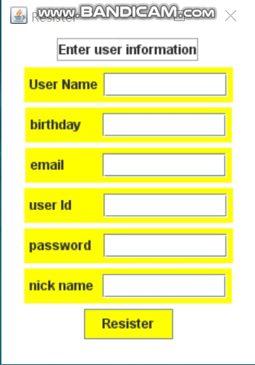
01
Resister/Withdrawal
Resister
Username
Birthday
Email
User id
Password
Nick name

Slide 4
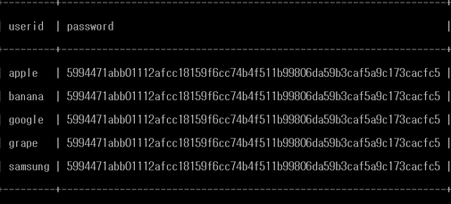
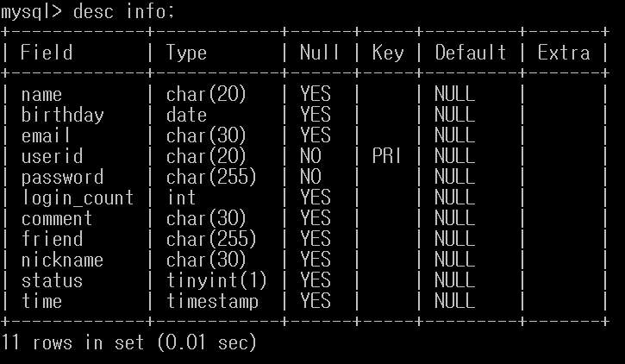
01
Resister/Withdrawal
DB/Encypt
DB/Attribute

Slide 5
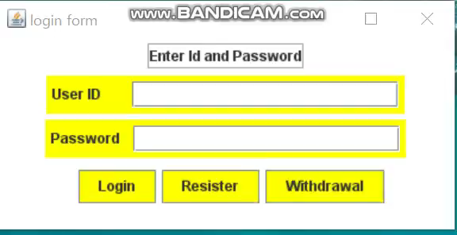
01
Resister/Withdrawal
Withdrawal
Client
“Welcome”/ “”
“Resister”+information / “Withdrawal+id+password”
Server

Slide 6
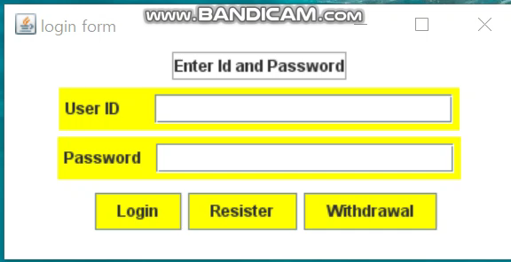
02
Login
Login success
Client
Access
+
userDatabase
"logid"+logid
+""+
encryptLogPW
Matching Success
Server

Slide 7
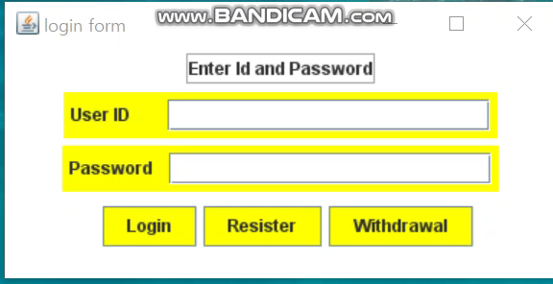
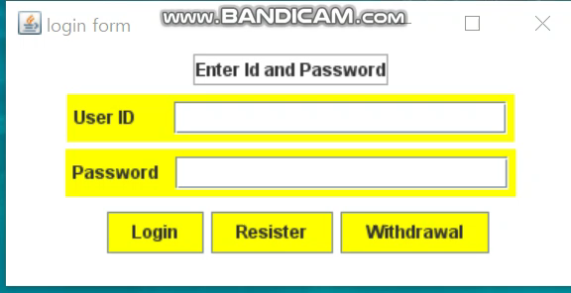
02
Login
Login fail
Matching Fail-Invalid ID
Matching Fail-Invalid-password

Slide 8
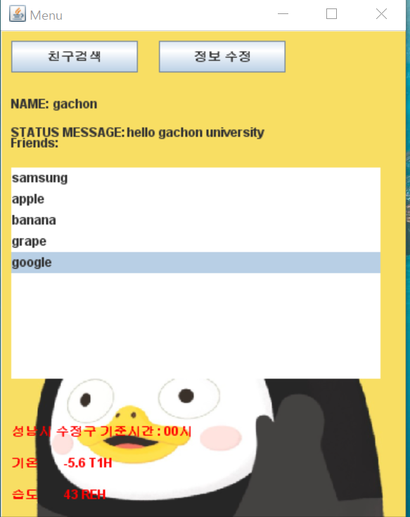
03
User/Managing friends
Main Menu
User Information
Friend List
공공데이터 Simple parser

Slide 9
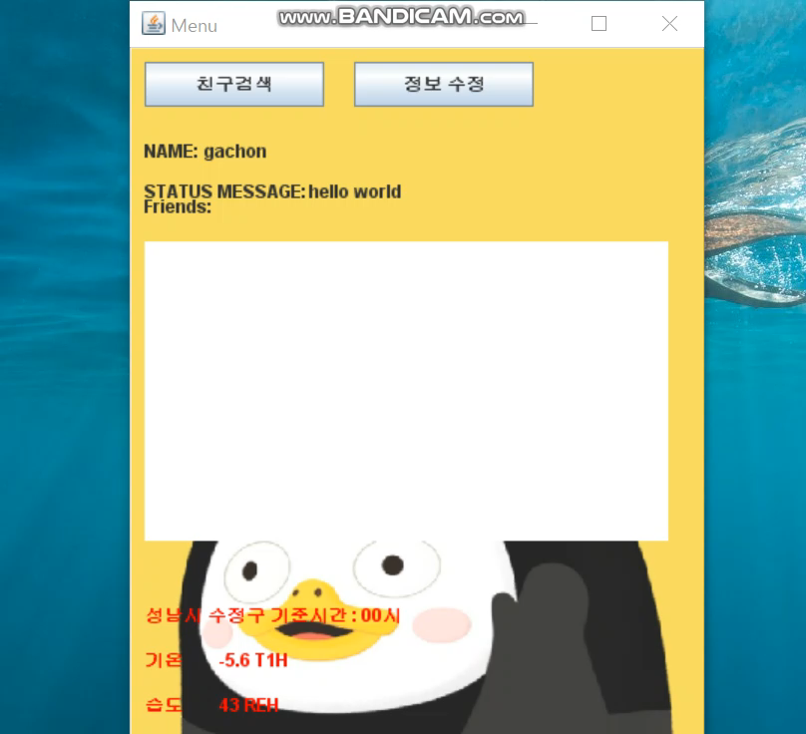
03
User/Managing friends
Change user information
Client
"ChangeInfo:"
+ch_nick+":"
+ch_comment
Server
Update database

Slide 10
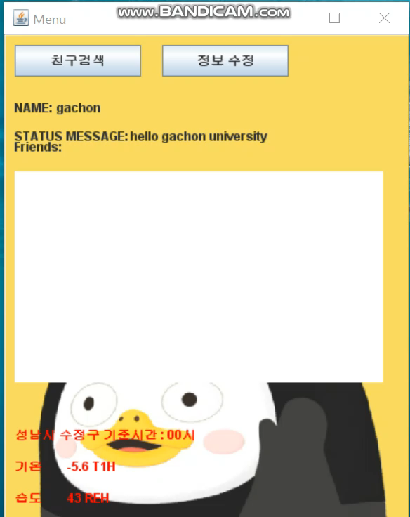
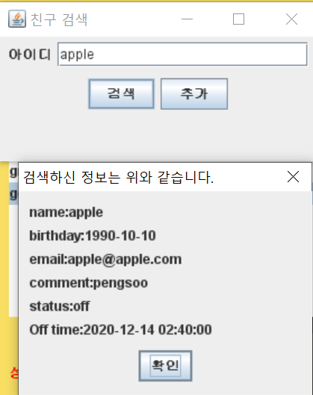
03
User/Managing friends
Search/ADD Friends

Slide 11
03
User/Managing friends
Search Friends
ADD Friends
Client
Client
"Searching"
+ Database
"Search”
+conveyid
ADD
"ADDF”
+relaid
Server
Server
Update database

Slide 12
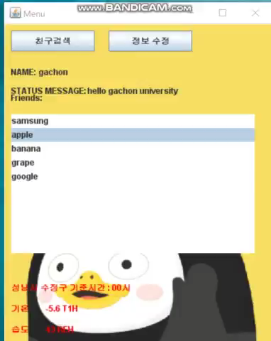
04
Chatting Room
Popup-show info, apply chatting
When you press the right button of the mouse, you can see the information of friends. Ex) birthday, Logout time, Login status
You can apply chatting request to friends

Slide 13
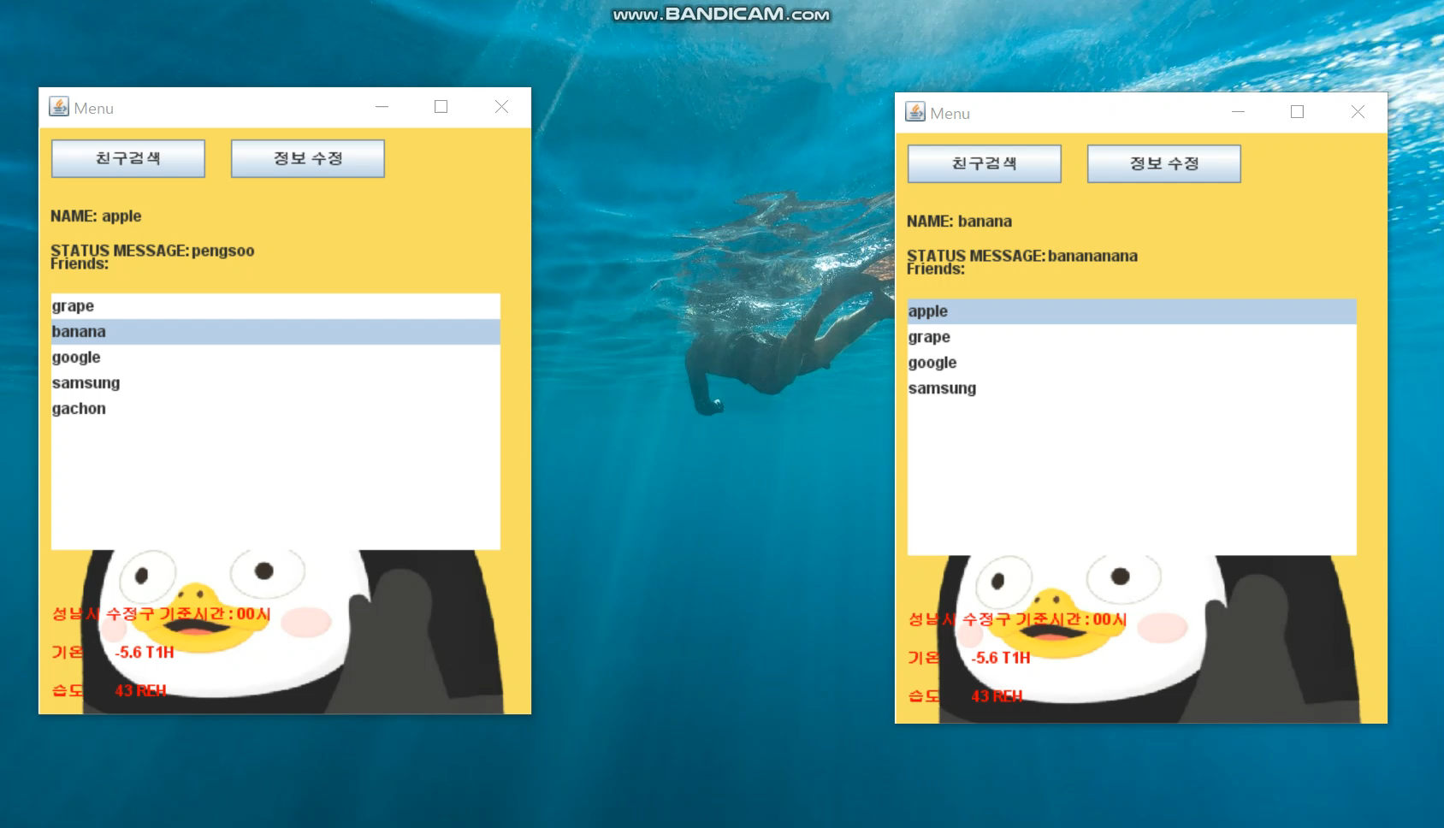
04
Chatting Room
1 : 1 Chatting

Slide 14
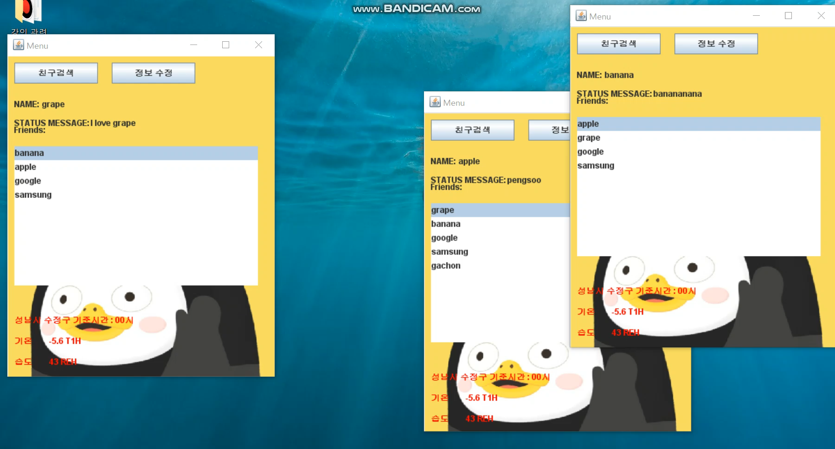
04
Chatting Room
1 : N Chatting

Slide 15
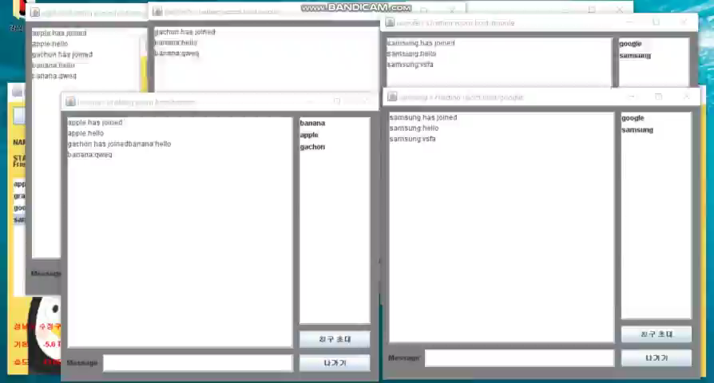
04
Chatting Room
Multi Chatting

Slide 16
04
Chatting Room
1 : 1 Chatting
“Start” + GUEST + HOST
Client: HOST
Server
“Request"+ GUEST
+HOST
Client: GUEST

Slide 17
04
Chatting Room
1 : N Chatting
Server
"chatting TEXT“
+host+":" +curid+":"+sendTF.getText()
Client
HOST
Client
Client

Slide 18
05
Members
장재혁
이주연
심우석
201533667
201632719
201636417
https://github.com/jaehyuck521/NetworkTermProject
https://github.com/JuYeon1234/NETWORK
https://github.com/dntjr41/computer_networking.git
Team’s github
https://github.com/JuYeon1234/NW_termproject_Team10
Team’s UTUBE
https://www.youtube.com/watch?v=T8ZiF5NSy9U

Slide 19
THANKS

